Slide 1
Deep Generative Models A Survey
Jianfei Chen

Slide 2
Overview
Discriminative models: p(y | x)
Generative models: p(x) （unlabeled data）
p(x, y) （labeled data）
Applications
Data generation
Semi-supervised learning:
learn p(x_unlabeled) p(x_labeled, y_labeled)
train p(x | y), and generate more data
Challenges
p(x) is significantly more difficult to model than p(y | x)
More complicated data (finite vs infinite)
Higher dimensionality (sample complexity)
More parameters (encoding labels vs encoding images)
Computational challenges: 100x slower

Slide 3
Roadmap
Generative Models
Tractable Models
PixelCNNs
Flows
VAEs
RealNVP
Glow
Flow++
VAE-IAF
PixelSnail
GANs
WGAN
LSGAN
SNGAN
SAGAN
BigGAN
PixelCNN++
VQVAE
IWAE

Slide 4
GANs
z
x=g(z)
Minimize some divergence between p_{D}(x) and p(x)=p(G(z))
example: KL divergence
Learn a classifier to

Slide 5
Tractable Models
VAE
Flow
PixelCNN

Slide 6
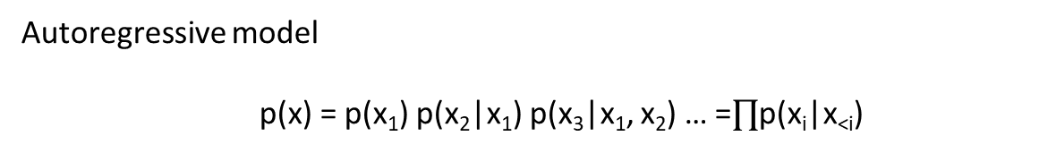
PixelCNN: Row LSTM
Layer
Row
x₀
x₁
x₂
x₃
Autoregressive model
p(x) = p(x₁) p(x₂|x₁) p(x₃|x₁, x₂) … =$∏$p(x_{i}|x_{<i})
Oord, Aaron van den, Nal Kalchbrenner, and Koray Kavukcuoglu. "Pixel recurrent neural networks." arXiv preprint arXiv:1601.06759 (2016).

Slide 7
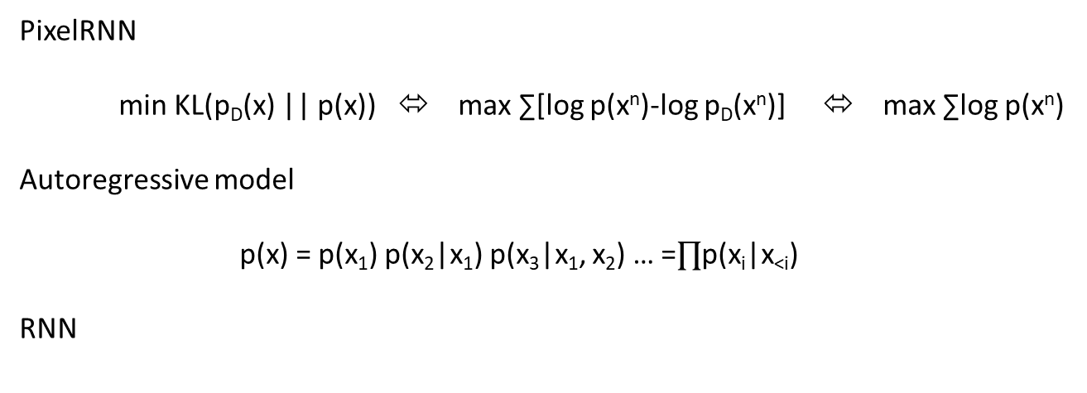
PixelCNN
PixelRNN
min KL(p_{D}(x) || p(x)) ⬄ max ∑[log p(x^{n})-log p_{D}(x^{n})] ⬄ max ∑log p(x^{n})
Autoregressive model
p(x) = p(x₁) p(x₂|x₁) p(x₃|x₁, x₂) … =$∏$p(x_{i}|x_{<i})
RNN
1-D seq
x₁
x₂
x₃
x₄
2-D grid
cell
cell
cell
cell
x₀
Oord, Aaron van den, Nal Kalchbrenner, and Koray Kavukcuoglu. "Pixel recurrent neural networks." arXiv preprint arXiv:1601.06759 (2016).

Slide 8
PixelCNN
CNN
CNN
CNN
CNN
Autoregressive model
p(x) = p(x₁) p(x₂|x₁) p(x₃|x₁, x₂) … =$∏$p(x_{i}|x_{<i})
Oord, Aaron van den, Nal Kalchbrenner, and Koray Kavukcuoglu. "Pixel recurrent neural networks." arXiv preprint arXiv:1601.06759 (2016).

Slide 9
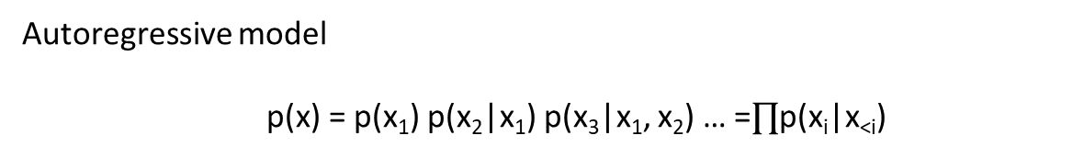
Masked convolution
kernel
1 | 1 | 1
1 | 0 | 0
0 | 0 | 0
CNN
Pro
fast training
fairly powerful
Con
slow sampling（pixel-by-pixel）
sensitive to order
Autoregressive model
p(x) = p(x₁) p(x₂|x₁) p(x₃|x₁, x₂) … =$∏$p(x_{i}|x_{<i})
Oord, Aaron van den, Nal Kalchbrenner, and Koray Kavukcuoglu. "Pixel recurrent neural networks." arXiv preprint arXiv:1601.06759 (2016).

Slide 10
Flows
Change-of-variables formula
p(x)dx = p(u)du ⬄ p(x)=p(u) |du/dx|
Four key ingredients
p(u) （normal distribution）
u=u(x)
x=x(u)
|du/dx|
u
NN
x

Slide 11
Flows
p(x)dx = p(u)du ⬄ p(x)=p(u) |du/dx|
Four key ingredients
p(u) （normal distribution）
u=u(x)
x=x(u)
|du/dx|
Compute p(x)
Compute u = u(x), and |du/dx|
Compute p(u)
p(x)=p(u) |du/dx|
Sampling
Draw u~p(u)
Compute x = x(u)
training
testing
training

Slide 12
Affine coupling layer
x = affinecoupling(u)
u1, u2 = split(u)
s, t = nn(u2)
x1 = u1
x2 = u2 * exp(s) + t
x = concat(x1, x2)
log|du/dx| = -sum(s)
u = affinecoupling⁻¹(x)
x1, x2 = split(x)
s, t = nn(x2)
u1 = x1
u2 = (x2 – t) / exp(s)
u = concat(u1, u2)
Residual structure

Slide 13
Invertible 1*1 conv
x = invertible1x1conv(u)
For each r, c
x(r, c) = Wu(r, c)
log |du/dx| = -log |W|
u = invertible1x1conv⁻¹(x)
For each r, c
u(r, c) = W⁻¹x(r, c)

Slide 14
Generative flows
Four key ingredients
p(u) （normal distribution）
u=u(x)
x=x(u)
|du/dx|
u
AffineCoupling
Invertible1x1Conv
Intractable |du/dx|
Intractable x=x(u), Variational dequantization
Invertible 3x3 conv
AffineCoupling
Dinh, Laurent, Jascha Sohl-Dickstein, and Samy Bengio.
"Density estimation using real nvp." arXiv preprint arXiv:1605.08803 (2016).
Kingma, Durk P., and Prafulla Dhariwal.
"Glow: Generative flow with invertible 1x1 convolutions."
Advances in Neural Information Processing Systems. 2018.
Invertible1x1conv
Chen, Ricky TQ, et al.
"Residual Flows for Invertible Generative Modeling." arXiv preprint arXiv:1906.02735 (2019).
AffineCoupling
Ho, Jonathan, et al. “
Flow++: Improving flow-based generative models with variational dequantization and architecture design."
arXiv preprint arXiv:1902.00275 (2019).
Invertible1x1conv
x
Hoogeboom, Emiel, Rianne van den Berg, and Max Welling.
"Emerging convolutions for generative normalizing flows." arXiv preprint arXiv:1901.11137 (2019).

Slide 15
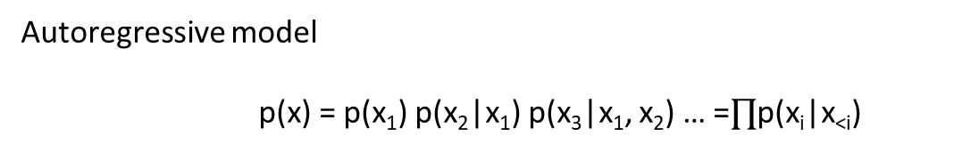
PixelCNN is a flow
Autoregressive model
p(x) = p(x₁) p(x₂|x₁) p(x₃|x₁, x₂) … =$∏$p(x_{i}|x_{<i})
For example
p(x_{i}|x_{<i})=N(mu(x_{<i}), sigma(x_{<i}))
xi = mu(x_{<i}) + exp(logsigma(x_{<i})) * u_{i}, where u_{i}~N(0, I)
inverse ui = (xi – mu(x_{<i})) / exp(logsigma(x_{<i}))
u->x: slow
x->u: fast
Change-of-variables formula
p(x)dx = p(u)du ⬄ p(x)=p(u) |du/dx|

Slide 16
VAE
min KL(p_{D}(x) || p(x)) ⬄ max ∑[log p(x^{n})-log p_{D}(x^{n})] ⬄ max ∑log p(x^{n})
Introducing latent variable z
p(x, z) = p(x|z) p(z)
log p(x) = ∑_{z} log p(x, z) >= E_{qz}[log p(x, z) – log q(z|x)]
Reparameterization trick
Let q(z|x) = q(u) |du/dz|
where z=z(u, x)
ELBO=E_{qu}[log p(x, z(u, x)) – log q(u) – log |du/dz|]
Kingma, Diederik P., and Max Welling. “
Auto-encoding variational bayes." arXiv preprint arXiv:1312.6114 (2013).

Slide 17
VAE
Reparameterization trick
Let q(z|x) = q(u) |du/dz|
where z=z(u, x)
ELBO=E_{qu}[log p(x, z(u, x)) – log q(u) – log |du/dz|]
p(z) = N(0, I)
p(x|z) = N(mu(z), sigma(z))
q(u) = N(0, I)
z(u, x) = mu(x) + u * sigma(x)
mu(z)
sigma(z)
mu(x)
sigma(x)
P-net
q-net
z
x

Slide 18
VAE-IAF
z
p(z) = N(0, I)
p(x|z) = N(mu(z), sigma(z))
q(u) = N(0, I)
z(u, x) = mu(x) + u * sigma(x)
mu(x)
sigma(x)
q-net
mu(z)
sigma(z)
x
u
Kingma, Durk P., et al. "Improved variational inference with inverse autoregressive flow."
Advances in neural information processing systems. 2016.

Slide 19
VAE-IAF
z
AffineCoupling
p(z) = N(0, I)
p(x|z) = N(mu(z), sigma(z))
q(u) = N(0, I)
z(u, x) = mu(x) + u * sigma(x)
x(u, z) = mu(z) + u * sigma(z)
Invertible1x1conv
mu(x)
sigma(x)
q-net
mu(z)
sigma(z)
x
u
Flows are VAE-IAFs with 0-dim z

Slide 20
VQVAE
x
VAE
z
PixelCNN
u
van den Oord, Aaron, and Oriol Vinyals. "Neural discrete representation learning." Advances in Neural Information Processing Systems. 2017.

Slide 21
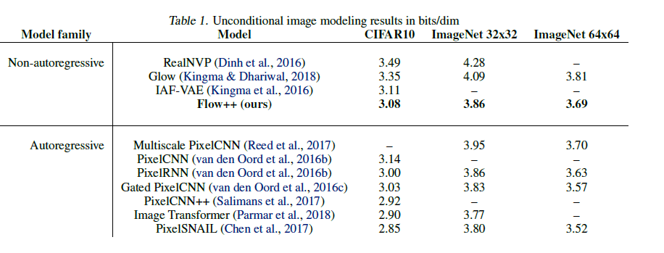
Current state-of-the-art

